Slide 1
Your presenters
Lynn Foster (will do the fun part in the middle)
Bob Haugen (will do the beginning and end)
We have a website, http://mikorizal.org/ , but we are not a business.
We have retired from careers as software developers for several businesses, and now do work for what we hope is the common good.

Slide 2

We use REA to develop software for economic networks.

Slide 3
An economic network is a set of independent Economic Agents who collaborate on creating and distributing Economic Resources.

Slide 4
Why REA?
The ALOE (Assets - Liabilities = Owner Equity) model does not work for networks, because a network does not have a singular ownership.
The REA independent view does work.

Slide 5
Here are some of the networks we have worked with on REA-based software:
http://www.fifthseasoncoop.com/ “A multi-stakeholder cooperative supporting a sustainable regional food system”
https://www.sensorica.co/ a pioneering Open Value Network
https://www.mutualaidnetwork.org/ “a new type of networked cooperative creating means for everyone to discover and succeed in work they want to do, with the support of their community”
https://learndeep.org/ a high-school fablab network.
https://www.facebook.com/thefaircoop/ “the Earth cooperative for a fair economy”

Slide 6
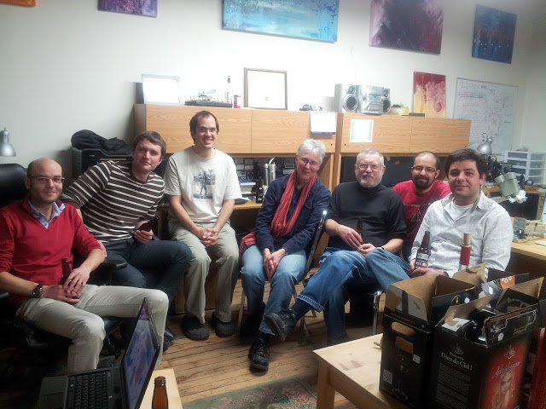
At Sensorica
(we know there’s a photo of Bill at Sensorica…)

Slide 7
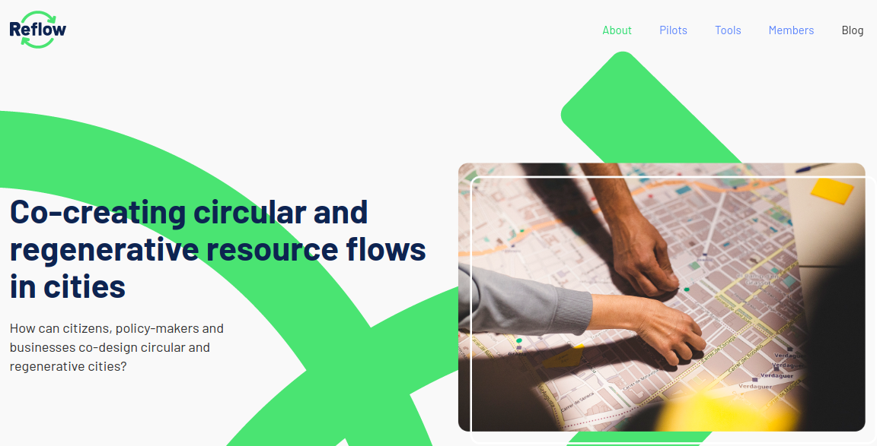
New project this year: https://reflowproject.eu/

Slide 8
Another new project this year: DisCO Project
DisCO stands for "Distributed Cooperative Organization"
Open Value Cooperativism and Distributed Cooperative Organizations (DisCOs)
They want to practice Contributive Accounting (a form of accounting where contributions to a shared project are logged to ensure fair distributions of income and livelihoods).
They learned it from Sensorica.

Slide 9
What can a network do that an enterprise can’t?
Many kinds of economic analysis over many enterprises, over a city, a region, a state, a nation, a planet.
For example, gap analysis to keep resources circulating more times in a community,
Or circular resource flows to reduce, re-use, and recycle resources in a community.

Slide 10

What can a network do that an enterprise can’t?
Or organize 1-piece resource flows in a whole supply chain

Slide 11
What can a network do that an enterprise can’t?
Farm and food economy analysis (of our home region):
Farmers lose $33 million each year producing food,
spend $135 million buying inputs from external suppliers,
for a total loss of $168 million to the region.
Meanwhile, consumers spend $208 million buying food from outside.
Total loss to the region: $376 million each year.
http://crcworks.org/crcdocs/wiviroquasum08.pdf

Slide 12
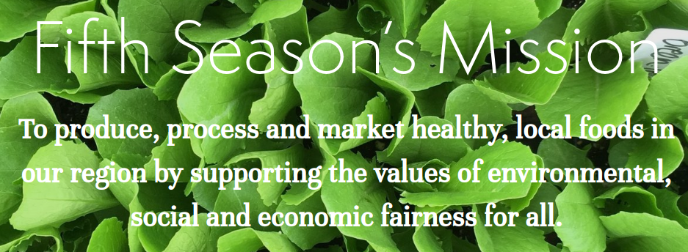
What can a network do that an enterprise can’t?
Farm and food economy analysis (of our home region): That analysis led directly to the formation of the Fifth Season Cooperative, to keep more food (and wealth) in the region.

Slide 13
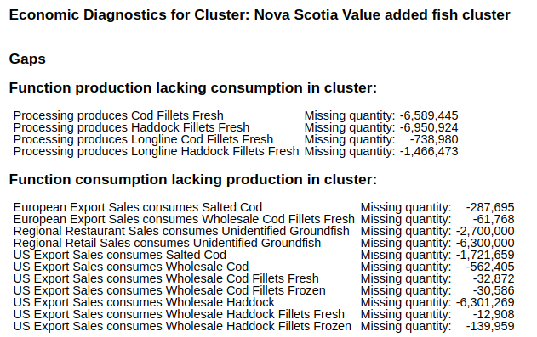
What can a network do that an enterprise can’t?

Slide 14
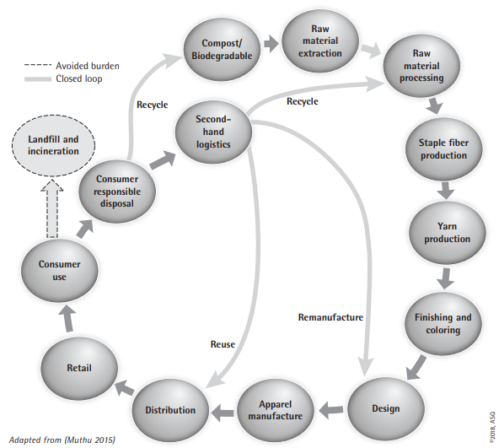
What can a network do that an enterprise can’t?
Reflow
clothing
circular
flows

Slide 15
...Transition...
How to implement
software for economic networks...

Slide 16
Conway’s Law
“Any organization that designs a system will produce a design whose structure is a copy of the organization's communication structure.”

Slide 17
So that means the appropriate structure for economic network software is a networked system composed of independent nodes:
One node per Agent.
No “parent company”: Peer to peer (P2P)

Slide 18
...and since they are independent, each Agent might use different software...

Slide 19
But that means the different Agents need to agree on a language and protocols for communication,
If they want to act as an economic network.

Slide 20
That’s where the Value Flows vocabulary comes in.

Slide 21
Value Flows was based on REA and our previous experience in developing software for economic networks.

Slide 22
Current implementations of REA and Value Flows:
Centralized:
  Network Resource Planning (NRP): with 42 forks: https://github.com/valnet/valuenetwork/network/members
    Documentation: https://speakerdeck.com/mikorizal
  Local Economic Analysis: http://locecon.org/
P2P following Conway’s Law (in progress):
  Holo-REA: https://github.com/holo-rea using https://holochain.org/
  CommonsPub: http://commonspub.org/ using http://activitypub.rocks/
  Basis project: https://basisproject.gitlab.io/public/

Slide 23
Here’s a short and sweet story about how Value Flows works.

Slide 24
Lynn’s pie story slides go here...

Slide 25
Kip Twitchell’s Predictions from last week:
• Any currency is fundamentally transferrable credit, whether issued by a government or any other entity. The most effective type of transferable credit over time is that which is backed by integrity--the commitment of the person issuing the promissory note to repay--as the value of any other asset in the future will always be uncertain.
This is very similar to a Mutual Credit network: a form of economic network that is used in the Mutual Aid Networks and some of our new systems under development now.

Slide 26
Kip Twitchell’s Predictions from last week:
• Trustworthiness begets efficiencies, efficiencies not available in any other way. Its power is akin to that of intelligence and knowledge. Those who are trustworthy will continue to find ways to enhance the efficiencies from interacting with those also committed to trustworthiness and integrity.
Supply chains rely on trustworthiness. The agents involved find each other, and work with each other over time, thus enhancing efficiencies. REA supports supply chains very well.

Slide 27
Kip Twitchell’s Predictions from last week:
• In the same way fundamental bookkeeping increases intelligence by accurately and understandably recording what has happened and projecting what will happen, trustworthiness and integrity increase efficiencies through community, sharing, specialization and mutual dependence.
A Mutual Credit system is essentially a bookkeeping system. And the Basis Project (slide 22) is a bookkeeping system for all resources.

Slide 28
Kip Twitchell’s Predictions from last week:
The resulting system will fundamentally be about organized, accurate, updatable, understandable, secure and accessible financial data. It will be broadly controlled by the owners of the data, their partners, both directly and speaking through their governments and other institutions. The change may be so radical it may upend the current concentration of capital.
We would replace “financial” with “all resources”. Such a system might not need money in its current form at all.

Slide 29
Kip Twitchell’s Predictions from last week:
• "Trustlessness," one of the Bitcoin blockchain goals, is a dead-end road.
All of the P2P systems described in these slides are “webs of trust”.
Bitcoin requires global consensus to implement “trustlessness”, which is slow, expensive, and requires more energy than the Czech Republic, a country of 10.6 million people.
Holochain, one of the environments listed here, can run on small personal computers. ActivityPub can run on even smaller devices. Both of those environments require agreement only among the participants in a transaction.

Slide 30
Examples of economic networks:
Business-as-usual:
  Supply chains
  Joint ventures
  Business ecosystems
  Local business networks
    Like local food networks, for example http://www.fifthseasoncoop.com/
Not business-as-usual:
  Open value networks (like Sensorica )
  Mutual credit networks (like https://danecountytimebank.org/ )
  Mutual aid networks
  Distributed Cooperative Organizations (like https://www.guerrillatranslation.org/ )
  Community economic systems (mostly talk, so far: for example Moinho, Brazil )

